Slide 1
Paging
Michael Hewner & Jeff Chase
Duke University

Slide 2
Memory management: user/kernel
Program (app or test)
User code: works for the user and program.
free
“0xA”
alloc
“0xA”
alloc
“0xB”
“ok”
Heap manager
Kernel code: works for the system and all of its users and programs.
mmap
system call, and other
syscalls involving mmap
OS kernel

Slide 3
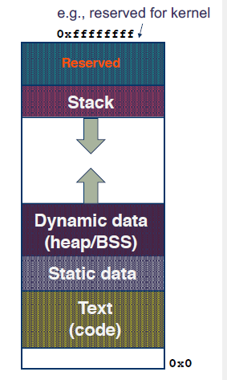
Virtual Address Space
Where are other programs in this picture?
This model of program memory isn’t real – its an illusion that the OS provides (with a significant assist from your CPU)

Slide 4
The addresses your program accesses are not “real” addresses
That is they do not correspond to an offset in your physical RAM
Instead the address your programs use are always virtual addresses
The virtual addresses are translated into physical addresses (which is what is passed to the memory hardware)

Slide 5
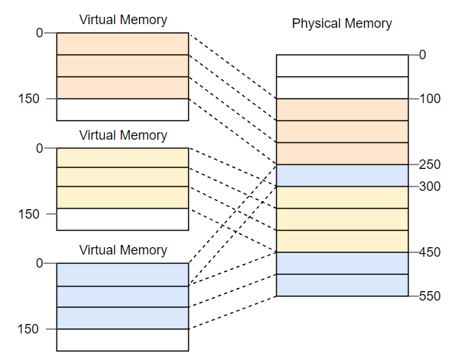
Paging: Overview
Rather than chop memory up into variable sized pieces, paging uses fixed-sized units called pages:
Each process has an address space that consists of fixed-size pages
Each page maps to a physical space frame (of the same size)

Slide 6

Paging: Address translation
Address generated by CPU is divided into:
Page number (p) – used as an index into a page table which contains base address of each page in physical memory
Page offset (d) – combined with base address to define the physical memory address that is sent by the MMU
Maximum page number = 2^{l} and page size 2^{m}
page number
page offset
l - m
m

Slide 7
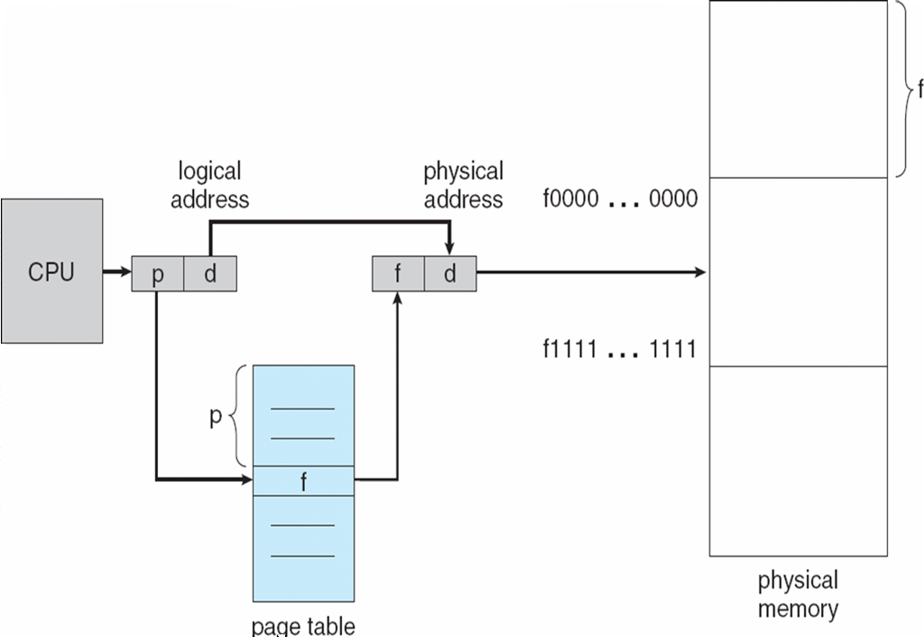
Paging: Address translation (cont.)

Slide 8
Every process has its own page table
The page table is in memory – in intel CPUs its address is set in the CR3 register. When a process switch occurs, we update this register.
Syscalls like mmap update the page table, mapping previously unmapped parts of a programs address space to frames in physical memory
This means that though some processes might seem to have identical addresses they map to different frames in the actual memory

Slide 9
Protections with Page Tables
Under normal circumstances, its impossible for a program to access the memory of another program – its addresses just don’t lead to the right parts of physical memory
If a program uses an address that’s unmapped in the page table, it triggers a page fault and the OS gets involved
Pages can also be annotated with other protections – e.g. whether they are writable, can contain executable programs and the CPU can enforce those rules
When a frame is initially allocated to a program it needs to be zeroed out (but its usually not safe to rely on this in C)

Slide 10
Paging: Pros
After setting up the page table, can be handled by hardware without the OS being involved
Lets programs hypothetically use a huge memory space, but we only have to actually give them the memory when they ask
Fixed size pages mean no external fragmentation, easy to find a page for a program that needs one
Easy to enforce memory protections

Slide 11
Paging: Cons
Each memory access actually requires 2 memory accesses (one to look up the entry in the page table, one to go to that entry)
Fixed size pages means wasted memory (internal fragmentation)
Page tables are overhead that use memory

